Slide 1

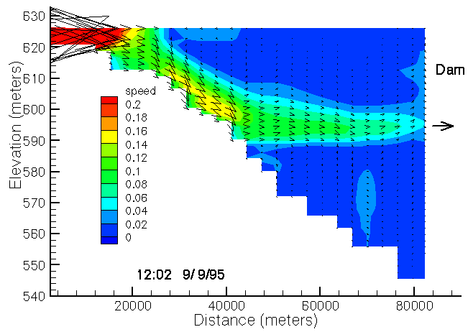
2D Hydrodynamic and Water Quality Model: CE-QUAL-W2 Version 4.5
Zhonglong Zhang, PhD, PH, PE
Research Professor
Portland State university
Todd Steissberg, PhD, PE
Research Environmental Engineer
U.S. Army Engineer Research and Development Center

Slide 2
CE-QUAL-W2
2D Hydrodynamic and Water Quality Model
Laterally-averaged longitudinal/vertical 2D hydrodynamic and water quality model – open source
Applicable to sloping rivers, lakes, reservoirs, and estuaries and any combination
Ability to model multiple water bodies and branches
Ability to model any number of general constituents, inorganic suspended solids, algal, periphyton, zooplankton, and CBOD groups and their impacts on algal/nutrient/dissolved oxygen interactions
Over 400 systems in the U.S. and throughout the world for reservoir operations, thermal and water quality studies
Over 40 years research and development

Slide 3
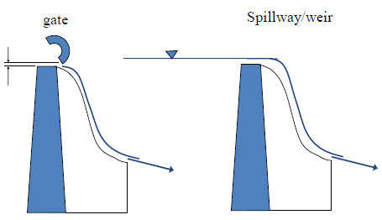
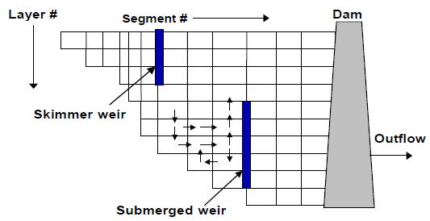
CE-QUAL-W2 Hydrodynamics
Pipes, pumps, spillways, gates, internal/external weirs, pump-storage
Downstream selective withdrawal
River Section
Reservoir Section
Slope=S=tanα
x
g
z
u
w
α
u
x
z
w
Auto-port selection from multi-port withdrawal structures
Added MINWL above powerhouse as a criterion for moving to a different selective withdrawal structure
Added capability to have dynamic port elevation active when a port selection rule is not active
Q_{out}

Slide 4
CE-QUAL-W2 Water Quality
General Constituents
Bacteria
CBOD
DGP, N2
TDG
Algae toxins
H2S, CH4, SO4, Fe(II), FeOOH, Mn(II), MnO2
Organic Carbon
Zero order
First order
Sediment diagenesis

Slide 5
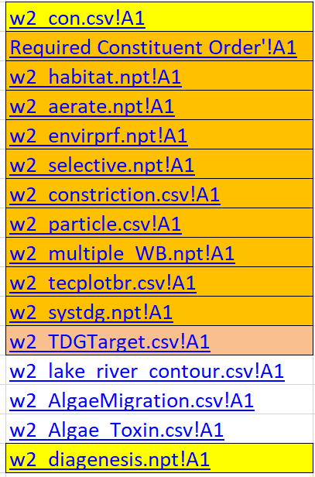
W2 Version 4.5 Excel Control Files
Excel file w2_con.xlsm → w2_con.csv
Simplified editing of input files
No graph.npt
Easier for cut and pasting
Simplified I/O
Files are better organized
Variable names and explanations at your fingertips
Formulae included in released Excel tool assist in control file development

Slide 6
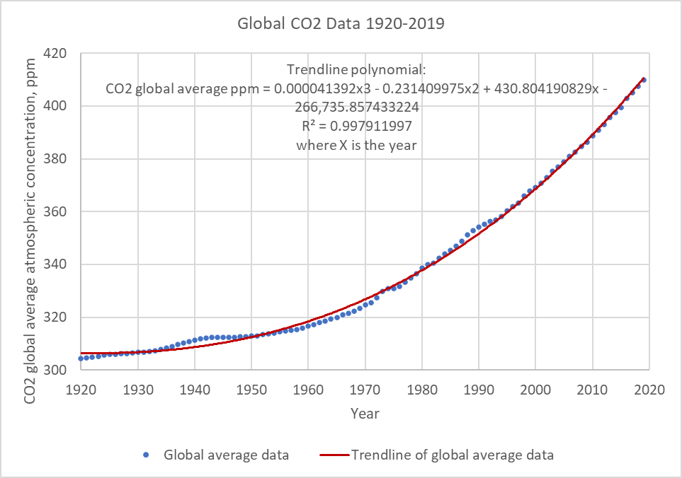
CO2 and Atmospheric Deposition
Atmospheric deposition: either dry or wet deposition (rain or snow) of pollutants contribute to the mass loading of a pollutant.
Dry deposition can include dust or particle transport associated with the pollutant.
The processes of atmospheric deposition include any state variables in CE-QUAL-W2 (such as N, P, and Hg) .

Slide 7
Organic Carbon Constituents

Slide 8

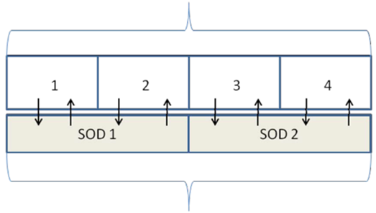
Sediment Diagenesis Module
Area
Inputs: csv format
Outputs: Bottom layer and averaged outputs
Simplified computations to steady-state
Add SOD and sediment fluxes for all water column layers
Add initial conditions for NO3 in sediment layers (layers 1 and 2)
Add an averaged SOD and sediment fluxes into the output for each segment
Add a subroutine for computing sediment POM and delete the corresponding parts in water-quality.f90
Add sediment POM (POC, PON and POP) computation (Subroutine SedimentPOM)
Add the correction for calculating SD_W12
Add a correction for PO4 partitioning coefficient in layer 1
Add partitioning of sediment NH4
Modify the numerical solution for CH4
Surface cell
Water Column
Bottom cell
Active Sediment Layer
Deep Sediments

Slide 9
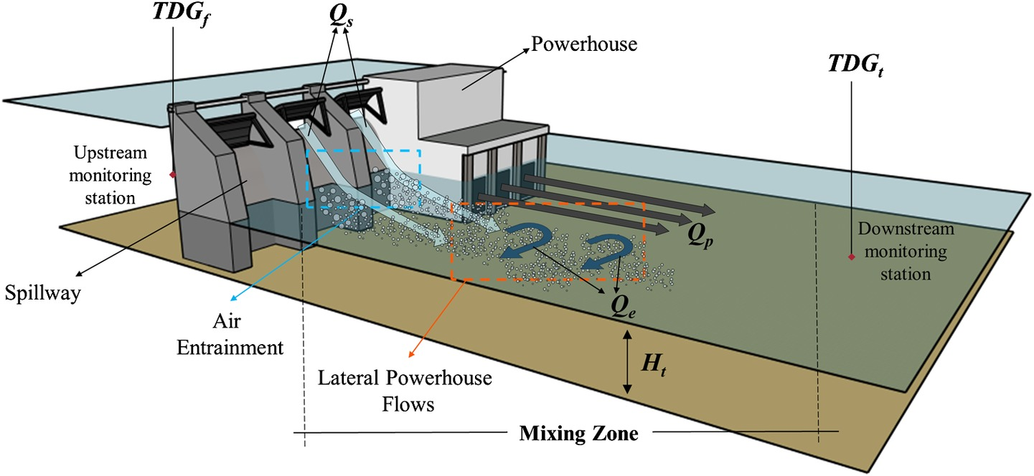
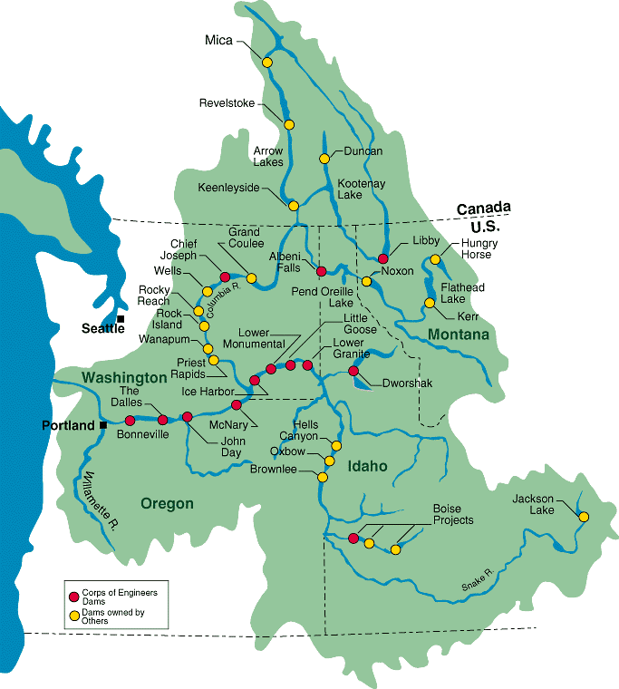
Total Dissolved Gas (TDG)
Estimates the forebay and tailwater TDG pressures resulting from reservoir operations.
TDG Computed from “N2+DO” and DGP

Slide 10
Mercury (Hg) Cycle Module
Elemental Hg Inorganic Hg Methylmercury
Conceptual Mercury Cycle in a Water Body

Slide 11
Acknowledgements
CE-QUAL-W2 Version 4.5 was specially supported by the ERDC Environmental Laboratory and Portland District of U.S. Army Corps of Engineers.
Model download:
http://www.cee.pdx.edu/w2/

